Slide 1
Monday, November 28
Good morning, happy Monday! Hope you’ve had a restful; break.
All outside work is due on Friday.
Quizzes are due by Sunday at midnight.

Slide 2
UNIT 6: Economic Growth
When you have completed this unit, you will be able to:
Define and calculate the economic growth rate, and real GDP per capita growth rate
Identify the determinants/sources of economic growth
Describe the policies that might speed economic growth

Slide 3
Growth as a Goal
Growth is a widely held economic goal.
When a nation can expand its output relative to its population, generally speaking, good things happen…
Wages and incomes increase
Standard of living increase
Production increases
Unemployment decreases, etc.
A growing economy can, in short, lessen the burdens of scarcity by consuming more, and therefore, producing more.
A growing economy means a nation is ready to undertake new endeavors by utilizing its goods and services more readily.

Slide 4
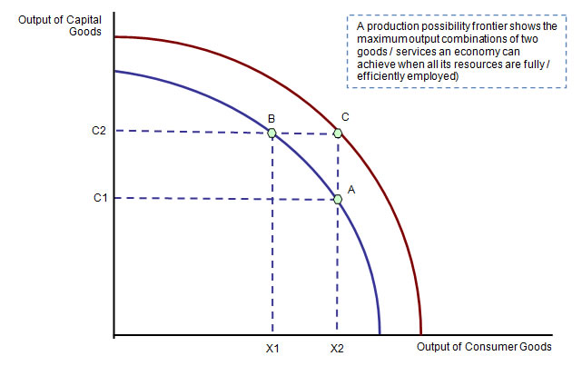
The Basics of Economic Growth
Economic growth is a sustained expansion of production possibilities measured as the increase in real GDP over a given period.
How do we show economic growth graphically on a PPF?
We can calculate for the Economic growth rate which is the annual percentage change of real GDP.

Slide 5
Calculating Economic Growth Rate
To calculate this growth rate, we use the formula:
Real GDP in current year
Real GDP in previous year
Growth of real GDP =
–
x 100
Real GDP in previous year
For example, if real GDP in the current year is $8.4 trillion and if real GDP in the previous year was $8.0 trillion, then the growth rate of real GDP is
Growth of real GDP =
$8.4 trillion – $8.0 trillion
x 100
= 5 percent.
$8.0 trillion
Notes:
Ask your class what kind of life people had in the year 1800 with an average income of $762 a year in current dollars. Answers will vary but many students are likely to respond that life was quite hard. Transportation was limited to horses, and meals were all prepared at home from scratch and cooked over an open fire. Medical care was quite meager (even the stethoscope was sixteen years away in the making) and entertainment was limited to books and song. In fact, very few people actually owned a book besides the Bible in 1800! By 1900 life was a bit better. The advent of the railroad made transportation much more practical and efficient. The potbelly stove was now available to cook meals and we had even conquered a few diseases along the way.
Compare old jobs with the new by looking at the year 1900 versus today and the changes that have taken place with their development. Ask your students if they recognize the list of professions below. Make sure only to list the professions without the descriptions. Students will probably recognize a handful but there should be a good number that they have not heard of before. It makes for a great icebreaker when discussing how the economic landscape of the country has changed.
[Continued on next slide]

Slide 6
Standard of Living
We can also measure growth based on the standard of living.
Standard of living depends on real GDP per person, or real GDP per capita.
Real GDP per capita is determined by the real GDP divided by the population.
The contribution of real GDP growth to the change in the standard of living depends on the growth rate of real GDP per person.
The growth rate of real GDP per person can also be calculated by using the formula:
Growth of real GDP per person
Growth rate of real GDP
Growth rate of population
=
–

Slide 7
Rule of 70
Economists pay attention to even the slightest of changes in growth – because it can mean big things over time.
Rule of 70 tells us that we can find the number of years it takes for the level of any variable to double, given its annual percentage increase, by dividing that increase by 70.
Number of Years to double real GDP =
$$\frac{70}{Annual percentage rate of growth}$$
What is the difference between 7% and 2%?

Slide 8
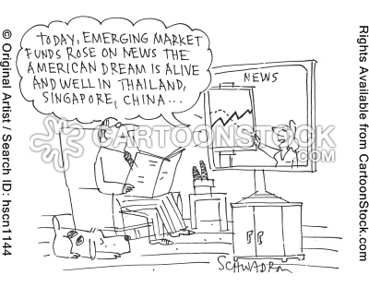
Economic Growth
Growth Rates
Growth rate Years for level (% per year) to double Example
2 35 U.S. real GDP per person
7 10 China real GDP per person

Slide 9
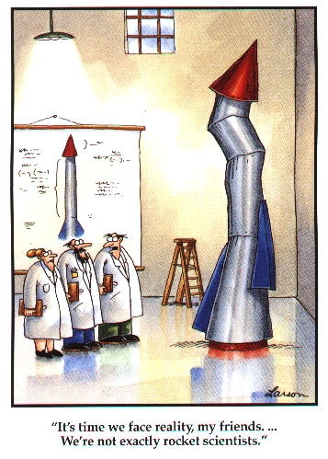
5 Sources of Economic Growth
Quantity of Labor – the amount of labor hours available within the economy.
Labor Productivity – the quantity of real GDP produced by one hour of labor.
Saving and Investing (I) in physical capital
Expansion of human capital
Technology

Slide 10
Labor Productivity
When labor productivity grows, real GDP per person grows, so the growth in labor productivity is the basis of rising living standards.
The growth of labor productivity depends on three things:
Saving and investment in physical capital
Expansion of human capital
Discovery of new technologies

Slide 11
Sources of Economic Growth
Saving and Investment in Physical Capital
Saving and investment in physical capital increase the amount of capital per worker and increase labor productivity.
Expansion of Human Capital
Human capital—the accumulated skill and knowledge of people —comes from two sources: Education and training, and Job experience
Technology
Some of the most powerful and far-reaching technologies are embodied in human capital. But most technologies are embodied in physical capital.

Slide 12
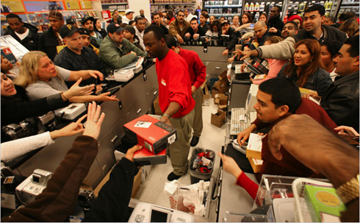
Six Determinants of Growth – Factors That Directly Affect the Rate of Growth
Supply-side Determinants: (1)Increases in quantity or quality of Natural Resources, (2) Human Capital, (3)Supply (stock) of capital goods, (4) Improved Technology
These supply factors enable a economy to physically expand its potential GDP which will cause a shift of the PPF or LRAS.
Demand-side Determinant: Households, firms and the government must purchase the economy’s expanding output of goods.
This is known as the demand factor of growth.
Efficiency Determinant: To reach it’s full production potential, an economy must achieve efficiency and full employment. This is the efficiency factor.

Slide 13
Theories of Economic Growth
Classical Growth Theory: exploding population, limited resources – Malthus
Neoclassical Growth: real GDP per capita will increase as long as technology progresses
New Growth Theory: theory that our unlimited wants will lead us to ever greater productivity and perpetual economic growth.
This creates perpetual motion in economy which is driven by insatiable wants that lead us to pursue profit and innovation.

Slide 14
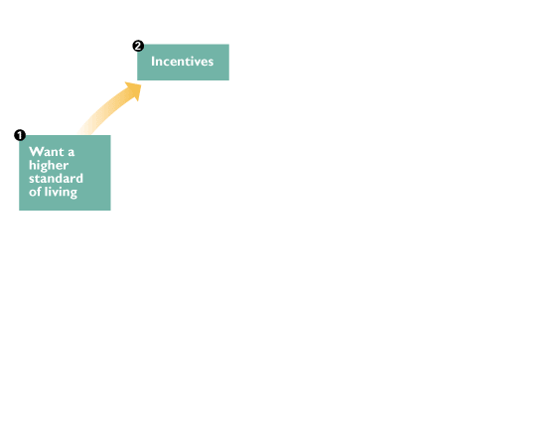
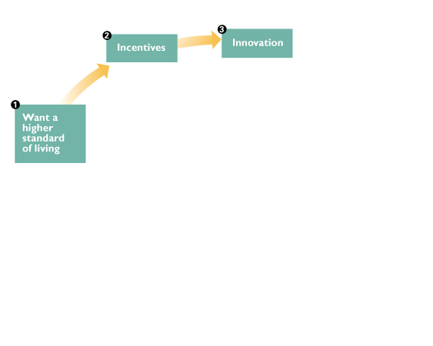
Perpetual Motion – New Growth Theory
The figure illustrates new growth theory in terms of a perpetual motion machine.
1. People want a higher standard of living and are spurred by...
2. Profit incentives to make the...
3. Innovations that lead to...

Slide 15
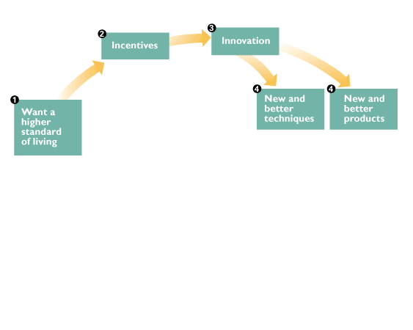
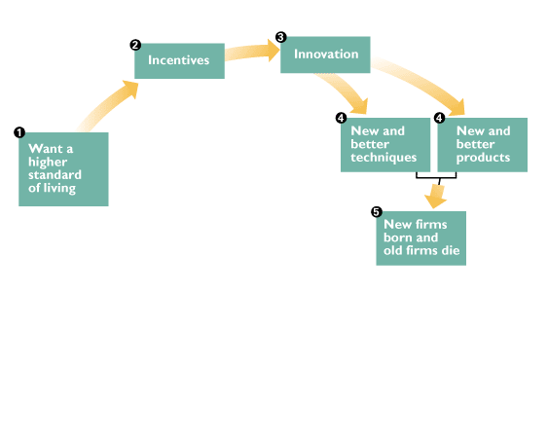
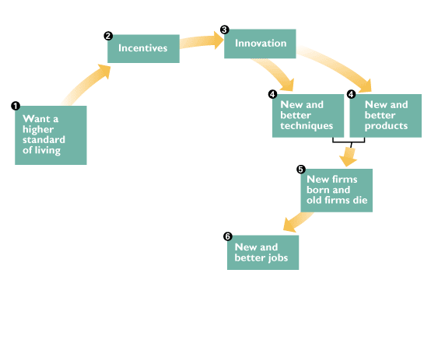
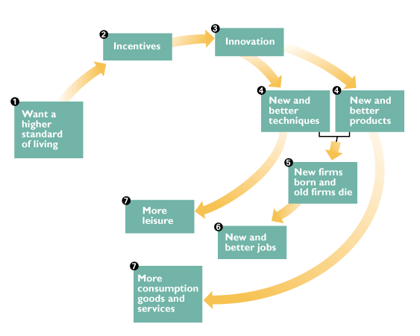
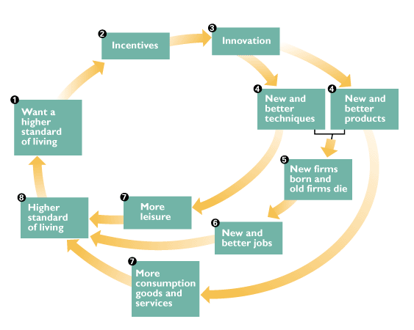

Slide 16
Perpetual Motion
4. New and better techniques and new and better products, which in turn lead to...
5. The birth of new firms and the death of some old firms,

Slide 17
Perpetual Motion
6. New and better jobs, and...
7. More leisure and more consumption goods and services.

Slide 18
Perpetual Motion
The result is...
8. A higher standard of living.
But people want a yet higher standard of living, and the growth process continues.

Slide 19
Benefits of Economic Growth
Higher Standard of Living
New and Better Jobs
New and Better Products
More Leisure
New and Better Techniques
Innovation
New Firms Born and old firms die (What do we call this?)

Slide 20
Preconditions of Economic Growth
Economic Freedom: the fundamental precondition for creating the incentives that lead to economic growth. People are able to make personal choices, their private property is protected, and they are free to buy and sell in markets.
Property Rights: the social arrangements that govern the protection of private property. Economic freedom requires the protection of private property—the factors of production and goods that people own.
Free Markets/Trade: the ability to pursue self-interest.
Efficient financial institutions
Literacy/Education

Slide 21
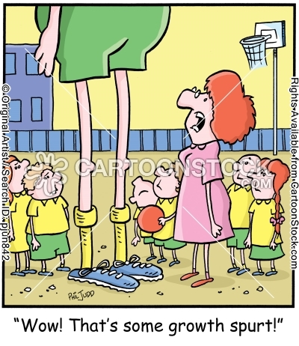
How can we achieve faster growth?
Create incentive mechanism - $$$$
Encourage Savings = $ for “I” – This happens through bank loans
Encourage research and development = innovation
Encourage international trade. Creates higher levels of economic efficiency and cheaper inputs
Improve quality of education = Why?

Slide 22
Policies to Promote Economic Growth
Fiscal Policy(taxes): aimed at investment, not consumption (tax credits for more capital)
Fiscal Policy (Spending): aimed at higher quality education and infrastructure.
Monetary Policy: lower interest rates to create more investment and increase capital.
Short Run impacts = increase AD
Long Run impacts = increase SRAS (productivity between human capital and infrastructure).

Slide 23
Growth vs. Return to Full Employment
Growth = right shift of the PPF or LRAS
Caused by the four supply factors: (1) Increase quantity and quality of natural resources, (2) increase quantity and quality of human capital, (3) increase in supply (stock) of capital goods, (4) improved technology.
All other increases in rGDP (AS or AD) are called “progress toward full employment”. These would be increases that move the economy out of recession.

Slide 24
Growth or Recovery – Draw the PPF, Phillips, and AS/AD graph and explain
For the month of November, U.S. unemployment was 6.5%.
You are the Economist, what would you do??
A. Help the nation recover to the natural rate of unemployment.
B. After the recovery, how would you grow the economy?

